Slide 1

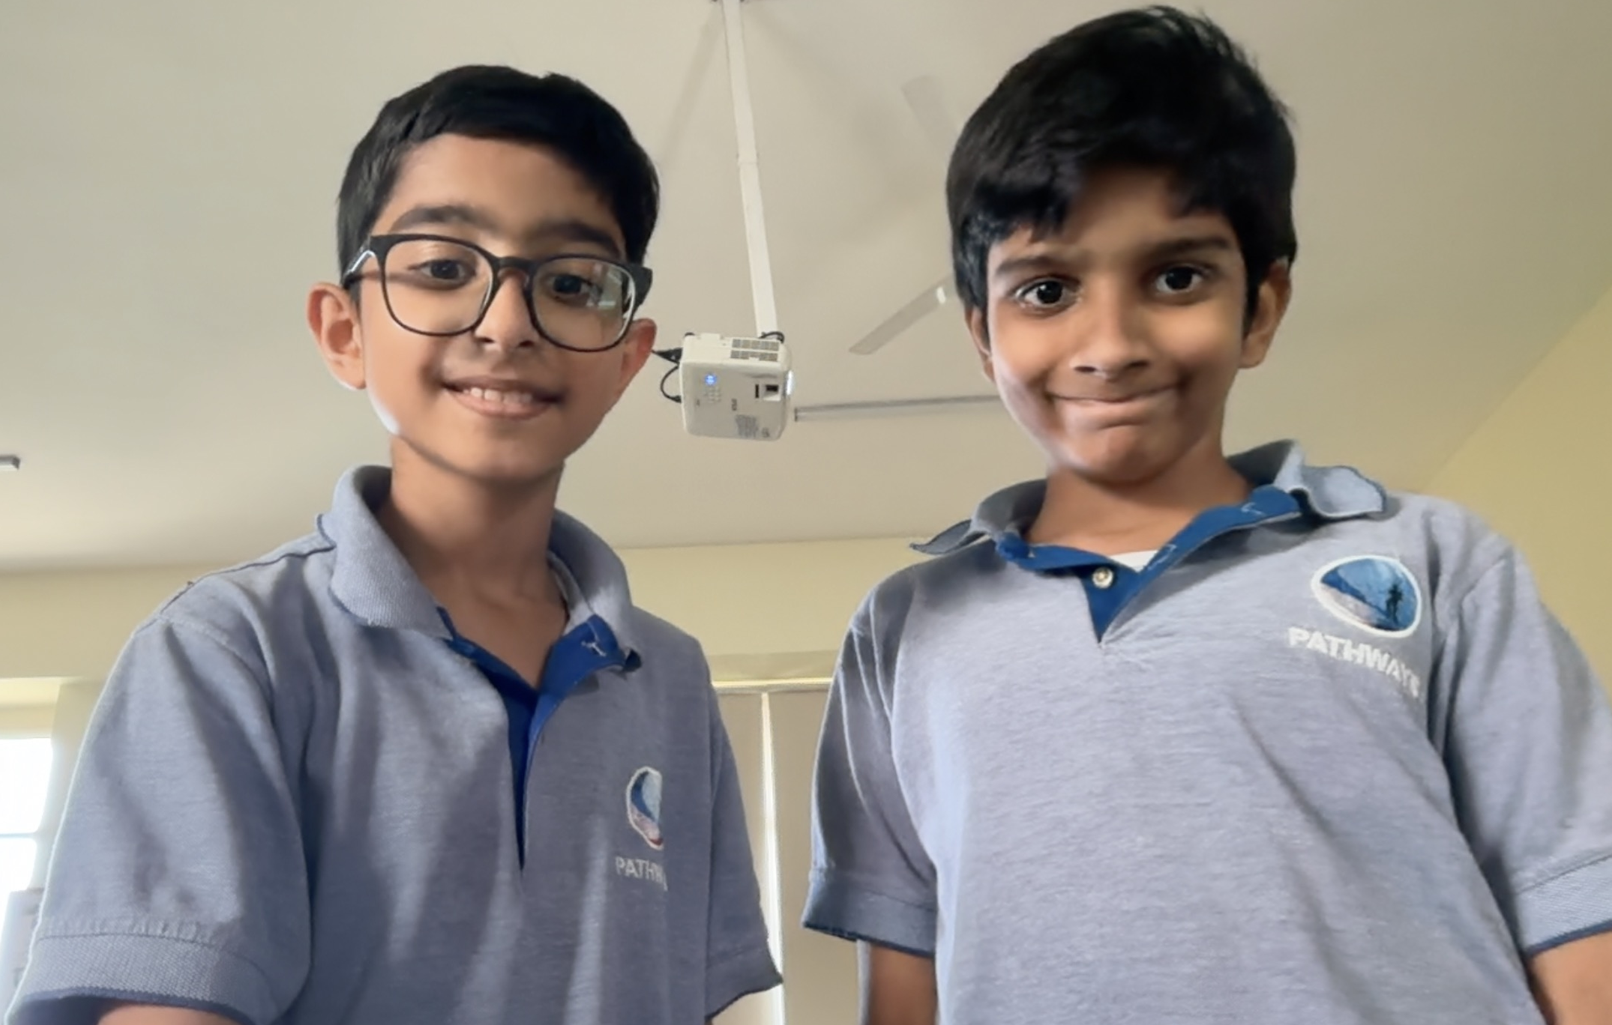
Anti-Alcohol
GSL Global Goals Competition
SDG-3.5
Saviours
Alcohol addiction is one of the most pervasive yet overlooked public health crises of our time. Fuelled by social pressure, emotional distress, and neurochemical dependency, it quietly dismantles families, careers, and lives. But we wanted change! Our project — rooted in rigorous research, compassionate outreach, and cutting-edge technology — represents a holistic, youth-driven response to a deeply entrenched societal problem. From school workshops to rehabilitation centre visits, from AI-powered counselling tools to grassroots poster campaigns, every action we took was designed to create lasting, measurable change.
TEAM
MENTOR
SCHOOL
Ms. Shreya Aggarwal
Pathways School
Gurgaon
Sankalp Kummra &
Dhruv Kharb
IB ATL Skills and Learner Profile Attributes we developed.
IB Learner Profile & ATL Skills
Inquirers:
Investigated causes & consequences of alcohol addiction
Through our GSL journey, we developed deeply as IB learners. As Inquirers and knowledgeable learners, we researched the neuroscience of addiction, exploring how dopamine, serotonin, GABA, and endorphin glands are disrupted by alcohol leading to a dependency, how surrogate and misleading advertisements benefit on legal loopholes, and much more on the basis of our lines of inquiry. As Communicators and Caring individuals, we conducted awareness workshops, reaching hundreds of students and adults. The Principled attribute guided our ethical outreach, ensuring sensitivity around addiction. Our Thinking Skills sharpened as we analysed surrogate advertising tactics and policy gaps and loopholes in the 1995 Cable Advertisement law. Research and Social ATL Skills were central to coordinating with 10+ NGOs and referring 116 people to rehab. Self-management Skills kept our team driven, organised, and purposeful throughout.
Thinkers:
Evaluated solutions and designed the Recoverly app
Communicators:
Workshops, interviews, and awareness campaigns
Risk-takers:
Approached a sensitive issue and tested new ideas

Slide 2
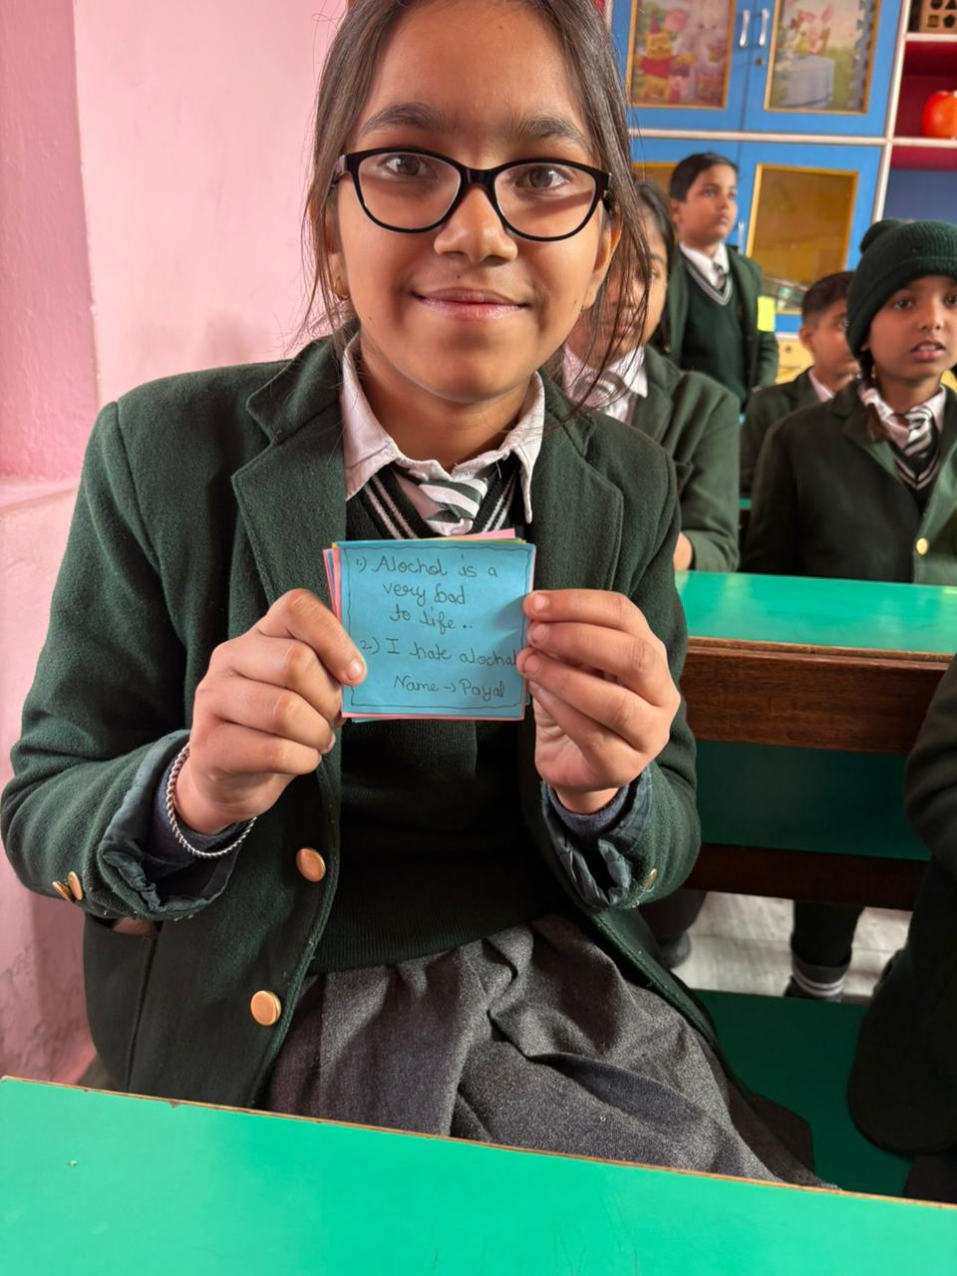
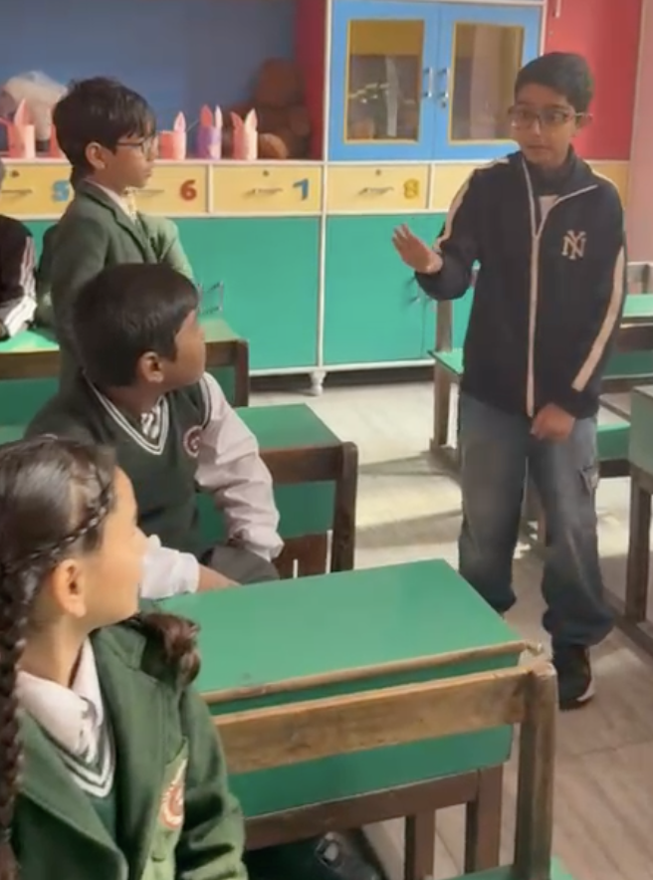
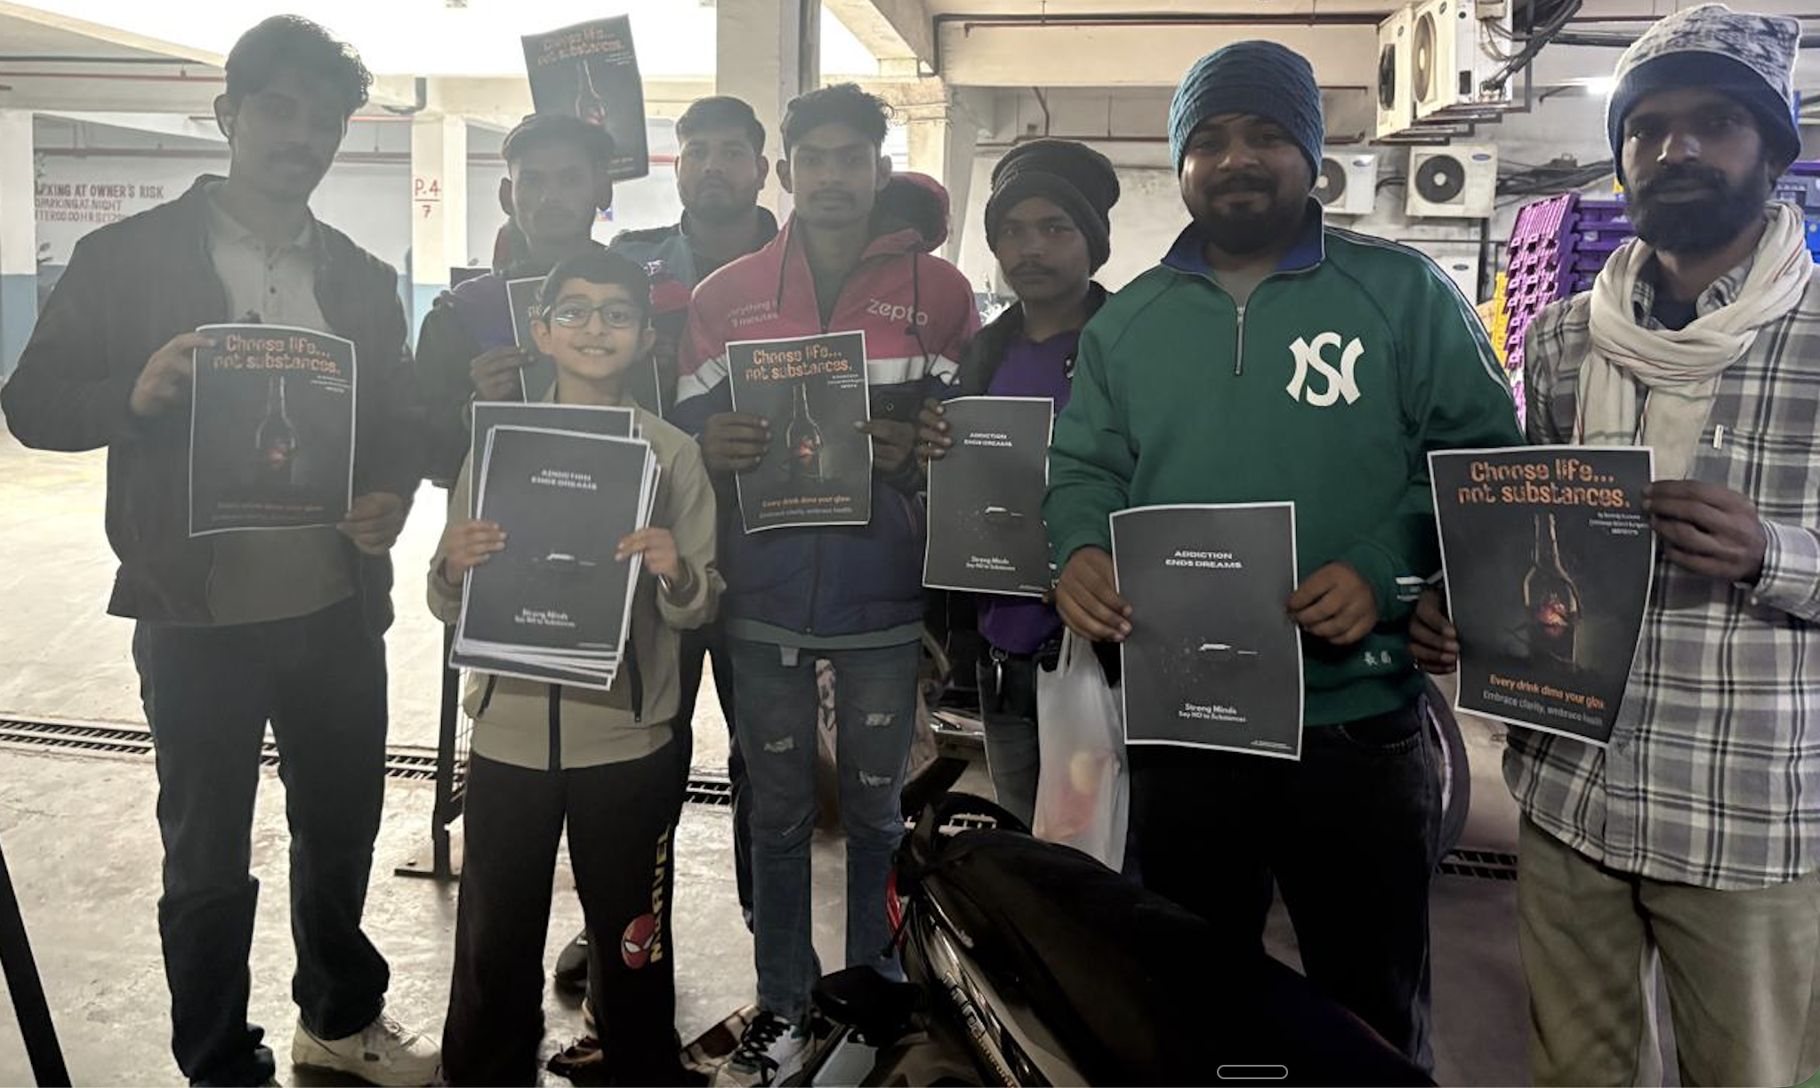
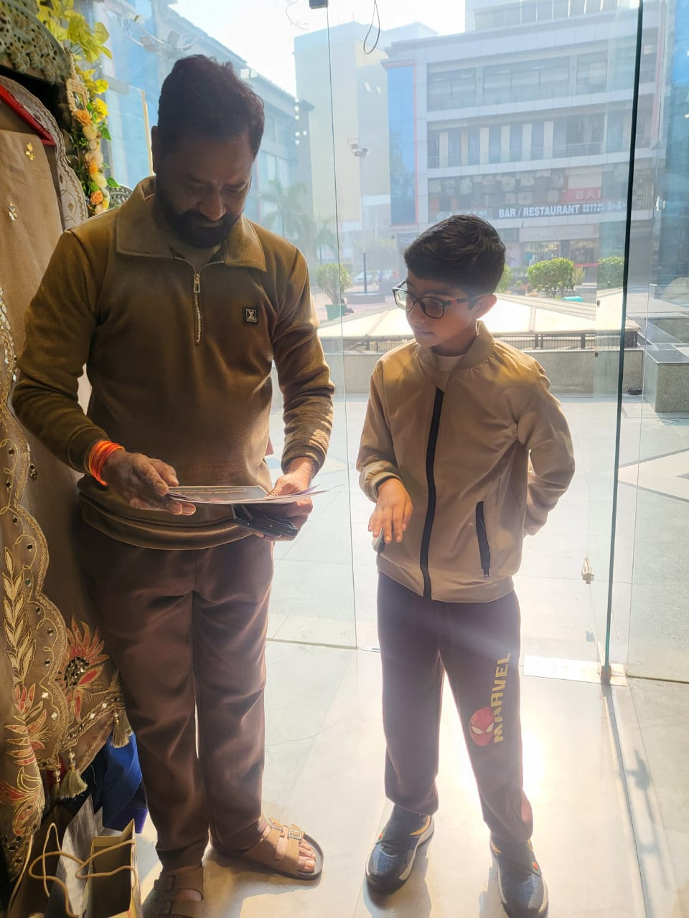
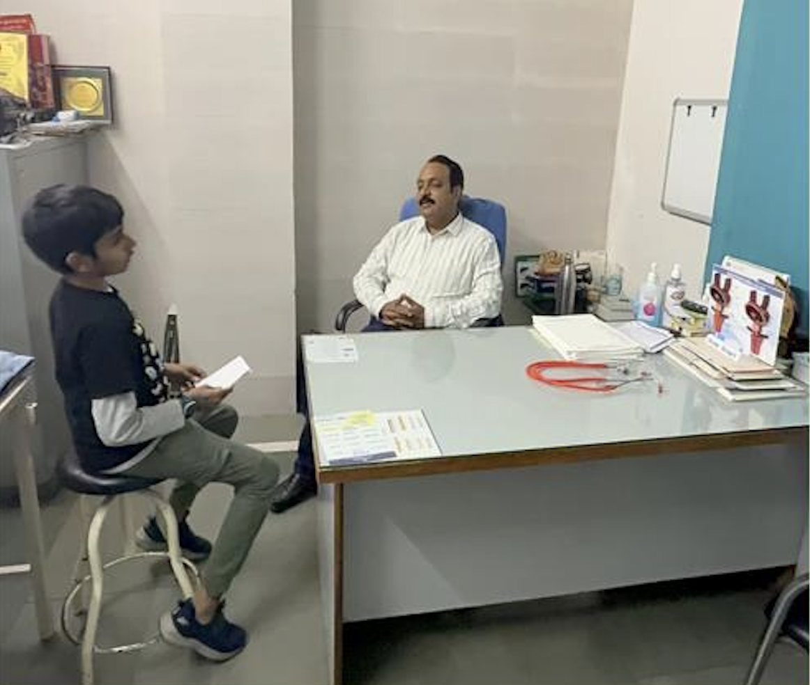
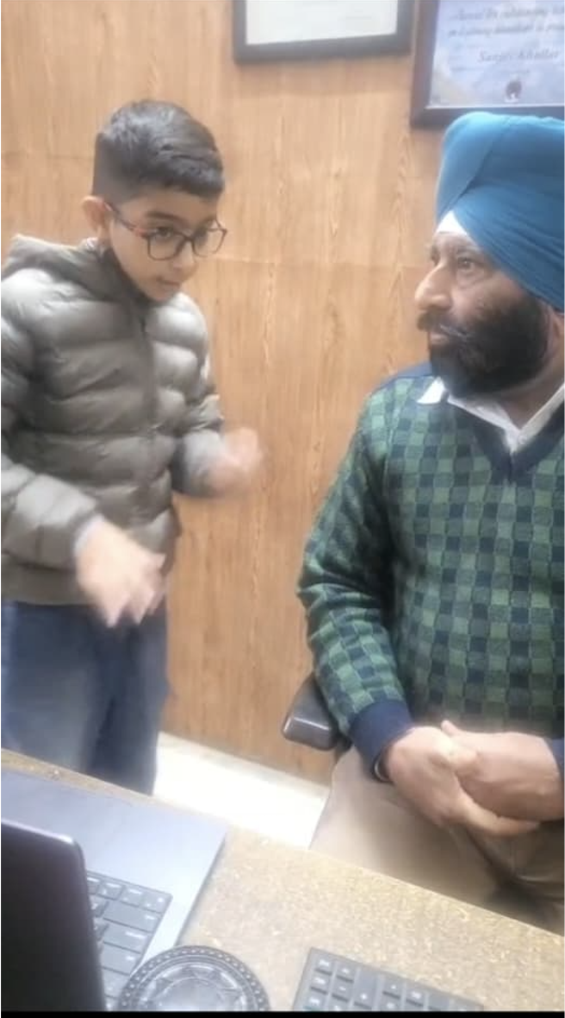
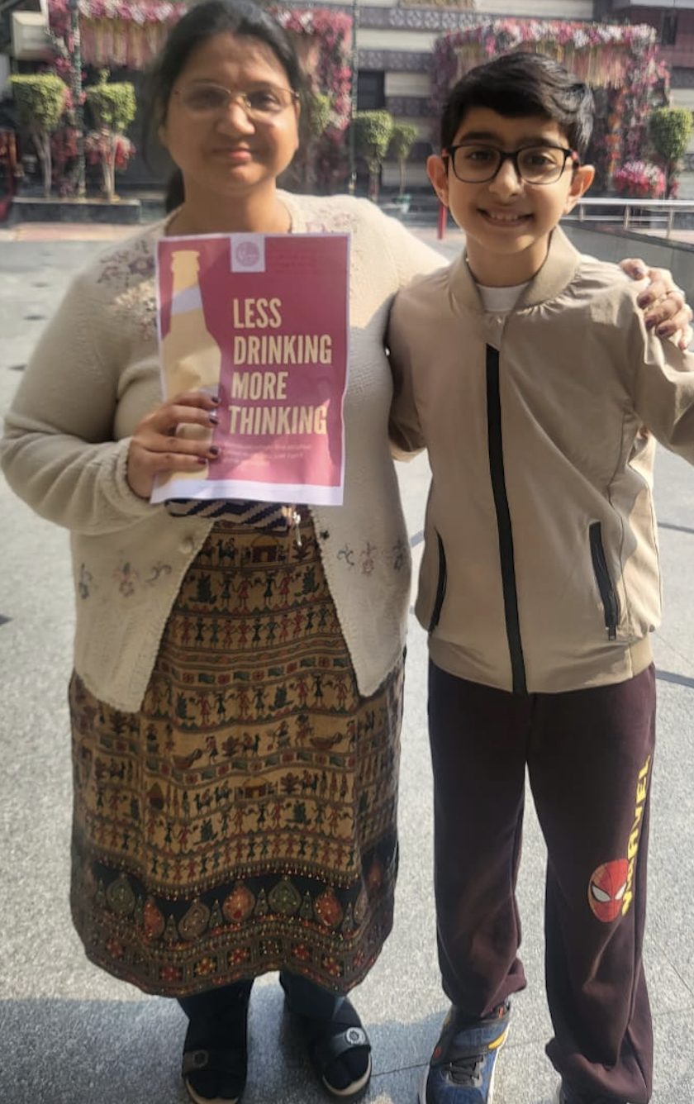
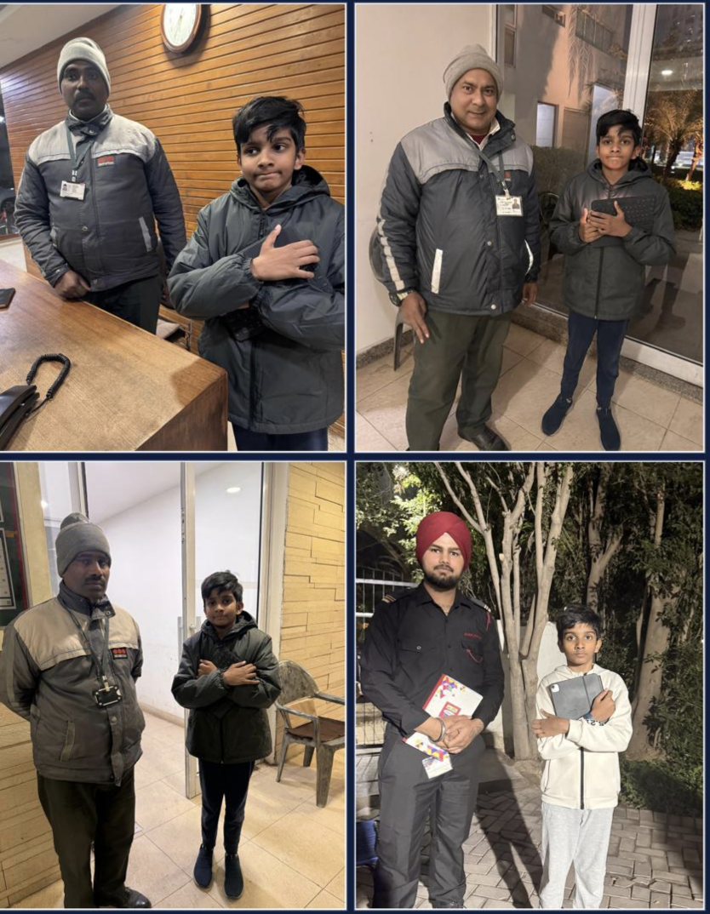
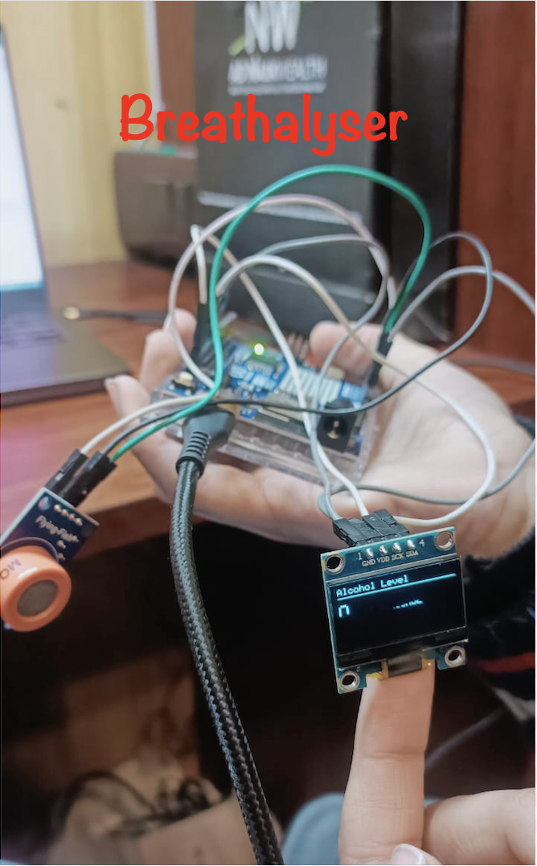
PROJECT JOURNEY
7 ACTIONS
Our Seven Actions: From Awareness to Real-Time Recovery
200+
People Reached Directly
116+
Individuals Sent to Rehab
7
Interconnected Actions
₹11,057
Breathalyser MRP
Workshop
Chain of awareness
School workshop at Flora Convent School for 4th and 5th-graders — spreading awareness about the harmful effects of alcohol in an age-appropriate, engaging format.
Designed and printed over 200 awareness posters, distributed at a Zepto warehouse to be delivered alongside customer orders — turning grocery deliveries into a vehicle for social change.
Interviews
Rehab Visit
Conducted mini-interviews with security guards, mall shoppers and clients. We also collaborated with Dr. NK Sharma, a globally recognised substance-abuse specialist, therapist and counselor and ended sending upto 116 people to a rehabilitation center(Naya Savera MANAS Center).
Visited Naya Savera TELE Manas Rehabilitation Centre — conducted mini-counselling sessions with recovering addicts, informing our app design and partnership plans. We also learnt about the neurohormonal gland loading and resetting technique- a widely used technique by all rehabs and recovery organsiations throughout the globe.
Pledge Campaign
Recoverly App
Organised a neighbourhood pledge drive — flyer posters across the community and on electric poles, requesting members to pledge sobriety and building local accountability.
To extend our impact digitally, we built Recoverly, a full-stack recovery application featuring a dashboard to log drinking data with visual bar graphs and line charts, a monthly improvement-scope tracker to celebrate progress, an AI-powered therapy and counselling assistant providing actual emotional support, and an integrated breathalyser calculating BrAC offering the same accuracy as ones worth 3 lakh rupees but at a lower price(including manufacturing cost, 18% GST and labour cost which is my hardwork)- Rs. 11,057 . The Naya Savera Ngo is actively using our app and breathalyser. The link to the app is https://recoverly-app.vercel.app/
6
Nasha Ka Sacha Hisaab
A Python programme that calculates the real financial and physical cost of alcohol consumption — showing users money saved over 1, 5, and 10 years if they stop drinking, immediate physiological consequences, and chronic risks including liver cirrhosis and cardiovascular disease.
Choose Life over Liquor
Choose Life over Liquor

