Slide 1
GSL CATALYST

Slide 2
PROJECT PROGRESS

Slide 3
Reflect on the following:
Project Idea
What you are currently working on
Any areas of challenges

Slide 4
Preparing for the application deadline

Slide 5
Rise Challenge Projects
Steps to completing the project…
01
02
03
Focus & Research
Design & Plan
Act & Reflect
Submit each part via video!
Notes:
Talking points:
Please use this slide to let audience know the steps to completing the Rise Challenge project
Sample script
“There are a few steps that you need to highlight when completing your project for the Rise Challenge, which includes research, design, and reflection.
Throughout the application, you will have the opportunity to describe your research and explain how it relates your passions, demonstrate how you designed and planned activities to accomplish your project outcomes, and reflect on your project journey and any key learnings you discovered in the process, all through video submissions.”
If you are presenting with a Rise Global Winner, please ask them to share their experience completing their Rise Challenge Project.
Sample script
“Can you share your thought process on how you prepared for the Rise Challenge?”
“How was the reflection process beneficial for you?”
“Was there a section or prompt that you enjoyed most from the Rise Challenge?”

Slide 6
PART 1
Focus & Research
Explain your project focus and how it links to your passions
Describe your research
Outline your research’s impact on your focus area and plans
Notes:
Optional Slide
Talking points:
Please use this slide to let audience know the steps to completing the Rise Challenge project

Slide 7
Notes:
Optional Slide
Talking points:
Please use this slide to let audience know the steps to completing the Rise Challenge project

Slide 8
PART 2
Design & Plan
Share the goals of your project
Explain what you designed and why it meets your project goals
Refer to the detailed plan you created to achieve your outcomes
Tell us about any ethical considerations you accounted for
Notes:
Optional Slide
Talking points:
Please use this slide to let audience know the steps to completing the Rise Challenge project

Slide 9
Notes:
Optional Slide
Talking points:
Please use this slide to let audience know the steps to completing the Rise Challenge project

Slide 10
PART 3
Act & Reflect
Outline what you did for your project with accompanying evidence
Compare your plans and how your project ran in practice
Reflect on the full project journey, with key learnings and anything that you would do differently if you started again
COMPLETE ALL THREE PARTS BY JANUARY 17, 2024!
Notes:
Optional Slide
Talking points:
Please use this slide to let audience know the steps to completing the Rise Challenge project

Slide 11
Notes:
Optional Slide
Talking points:
Please use this slide to let audience know the steps to completing the Rise Challenge project

Slide 12
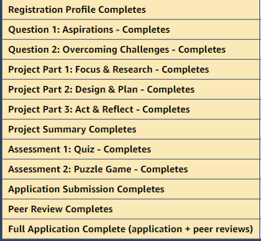
Peer Review
Outline
Applicants are required to provide peer review on three projects after submitting their own. In each case, you’ll review a minimum of three submissions of your peers by answering select questions. The more videos you review, the more perspective and inspiration you’ll gain.
You have until 4.59pm GMT on 31 January 2024 to complete the peer review section of your application.
Notes:
Optional Slide
Talking points:
Please use this slide to let audience know the steps to completing the Rise Challenge project

Slide 13
VIDEO SUBMISSION
Decide which platform you'll be using to record your video submission for the Rise Application
Write up notes or a script in terms of what you want to say for each part of the application
Reflect on the key points you want to highlight and ensure that you outline the issue you are addressing and why you have chosen to focus on this.

Slide 16
VIDEO EDITING

Slide 17
VIDEO SUBMISSION

Slide 18
Think about the following:
How you plan to present your project via the video submission? What is your plan?
What are the main points you want to get across?

Slide 19
RESOURCES

Slide 20
GSL CATALYST WEBPAGE
Notes:
GSL Catalyst | Changemakers - Global Social Leaders

Slide 21
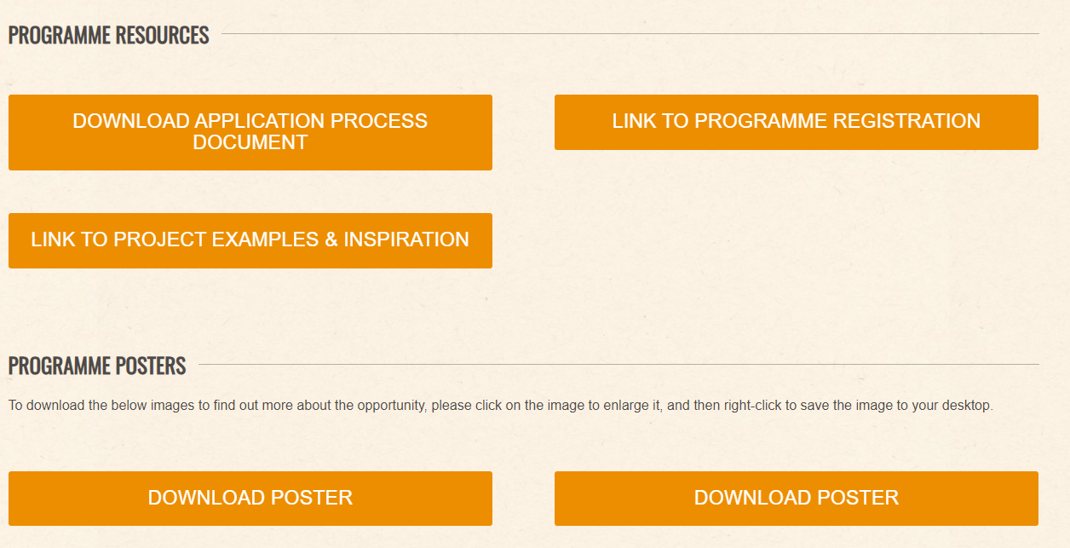
RESOURCES

Slide 22
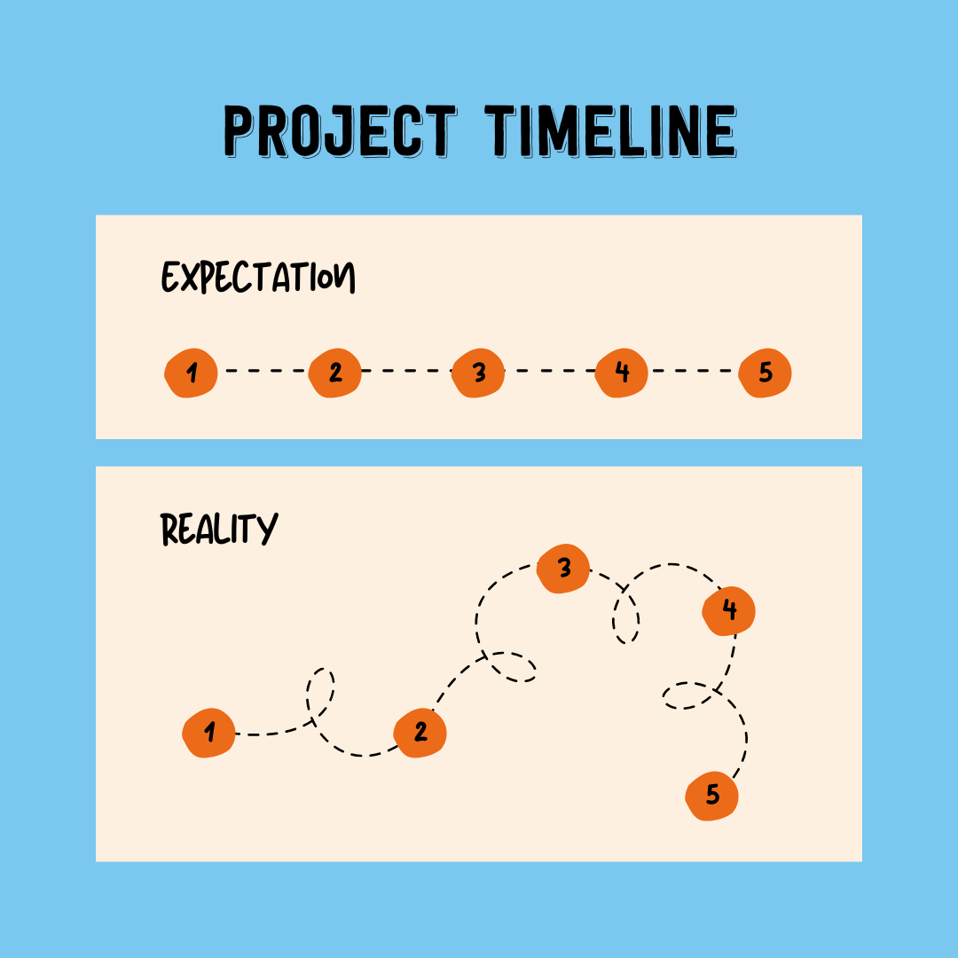
Notes:
Also we can go backwards in order to go forwards – school in Jordan – wanted to take a bus to refugee camp couldn’t ended up setting a new place for children to go
- Make sure we have examples of real life projects

Slide 23
NEXT STEPS & KEY DATES
Rise Application Deadline: 17th January 2024
Peer Review Sessions: Jan 2024

Slide 24
GOOD LUCK!
Global Social Leaders (Instagram)
FutureFound (Twitter)

