Slide 1
What is the Rise project?
Rise Challenge projects should benefit your community using any form of talent
Notes:
Talking points:
Please use this slide to let audience know of the about the Rise project
Sample Script:
“Let’s get a little deeper into what the Rise project is.
Projects for the Rise Challenge should benefit your community using any form of ability, skill, or talent.”

Slide 2
Rise Challenge Projects
Steps to completing the project…
01
02
03
Focus & Research
Design & Plan
Act & Reflect
Submit each part via video!
Notes:
Talking points:
Please use this slide to let audience know the steps to completing the Rise Challenge project
Sample script
“There are a few steps that you need to highlight when completing your project for the Rise Challenge, which includes research, design, and reflection.
Throughout the application, you will have the opportunity to describe your research and explain how it relates your passions, demonstrate how you designed and planned activities to accomplish your project outcomes, and reflect on your project journey and any key learnings you discovered in the process, all through video submissions.”
If you are presenting with a Rise Global Winner, please ask them to share their experience completing their Rise Challenge Project.
Sample script
“Can you share your thought process on how you prepared for the Rise Challenge?”
“How was the reflection process beneficial for you?”
“Was there a section or prompt that you enjoyed most from the Rise Challenge?”

Slide 3
PART 1
Focus & Research
Explain your project focus and how it links to your passions
Describe your research
Outline your research’s impact on your focus area and plans
Notes:
Optional Slide
Talking points:
Please use this slide to let audience know the steps to completing the Rise Challenge project

Slide 4
PART 2
Design & Plan
Share the goals of your project
Explain what you designed and why it meets your project goals
Refer to the detailed plan you created to achieve your outcomes
Tell us about any ethical considerations you accounted for
Notes:
Optional Slide
Talking points:
Please use this slide to let audience know the steps to completing the Rise Challenge project

Slide 5
PART 3
Act & Reflect
Outline what you did for your project with accompanying evidence
Compare your plans and how your project ran in practice
Reflect on the full project journey, with key learnings and anything that you would do differently if you started again
COMPLETE ALL THREE PARTS BY JANUARY 17, 2024!
Notes:
Optional Slide
Talking points:
Please use this slide to let audience know the steps to completing the Rise Challenge project

Slide 6
Rise Project Examples

Slide 7
RISE Project Profiles
Kenya
Egypt
México
Christian Maboko
Ola Saber
Valentina Barrón García
Organized a workshop in Kakuma Refugee Camp to teach fellow refugees about sexual health.
Developed an app that integrates AI and psychology to boost confidence and self-awareness.
Developed a hydroponic system for elderly to harvest fruits and vegetables in a rural community.
Notes:
Talking points:
Please use this slide to let audience know the variety of Rise projects
If you have a Rise Global Winner from your organization, this would be a great opportunity to highlight their project and how your organization supported them through the process

Slide 8
RISE Project Profiles
United States
South Africa
Brazil
Meera Dasgupta
Michael John Olivier
Guilherme Ricci Coube
Compiled an art anthology to empower women of color, as the youngest National Youth Poet Laureate.
Taught young students how to think and act like an entrepreneur in his fight to alleviate poverty.
Established a nonprofit to deliver devices and connect underprivileged communities to the internet.
Notes:
Talking points:
Please use this slide to let audience know the variety of Rise projects
If you have a Rise Global Winner from your organization, this would be a great opportunity to highlight their project and how your organization supported them through the process

Slide 9
RISE Project Profiles - Latin America
Guatemala
Brazil
México
Ester Noemí Bocel Chopén
Ana Beatriz Campos
Antonio Leyva Jara
Developed a program to help young women learn about opportunities and discover their voices.
Co-created a group to help students find scholarships and other educational opportunities.
Developed a math and science club to help young students learn these subjects in innovative ways.
Notes:
Optional Slide- RGW Project Profiles Region Specific
Talking points:
Please use this slide to let audience know the variety of Rise projects
If you have a Rise Global Winner from your organization, this would be a great opportunity to highlight their project and how your organization supported them through the process

Slide 10
RISE Project Profiles - East Africa
Kenya
Tanzania
Madagascar
Marrieta Kazungu
Oliver Godliving Lukuba
Naïma Nissaraly
Developed rapid covid breathalyzer to provide testing in rural areas to those who cannot afford it.
Secured funding to install a pad vending machine at her school.
Implemented two techniques of filtering water, which she hopes can be used in her community.
Notes:
Optional Slide- RGW Project Profiles Region Specific
Talking points:
Please use this slide to let audience know the variety of Rise projects
If you have a Rise Global Winner from your organization, this would be a great opportunity to highlight their project and how your organization supported them through the process

Slide 11
RISE Project Profiles - West Africa
Burkina Faso
Ghana
Nigeria
Antonio Kambiré
Henrietta Boateng
Ikenna Charles Nwafor
Created an organization called CMath and a platform to help students access resources to prepare for Olympiad competitions.
Educated the public on recycling and the effects of plastic waste on the environment.
Developed a website to educate Nigerian teens on the importance of cybersecurity.
Notes:
Optional Slide- RGW Project Profiles Region Specific
Talking points:
Please use this slide to let audience know the variety of Rise projects
If you have a Rise Global Winner from your organization, this would be a great opportunity to highlight their project and how your organization supported them through the process

Slide 12
RISE Project Profiles - North America
United States
Canada
United States
Aadya Bhat
Adam Dhalla
Renee Wang
Tackled the issue of accessibility in the retail industry and created a prototype for shelves that would improve access for disabled people.
Created an innovative machine learning algorithm that classifies the locations of proteins within cells.
Created an innovative tiny home that provides a dignified and independent lifestyle to those unhoused while still maintaining affordability and sustainability.
Notes:
Optional Slide- RGW Project Profiles Region Specific
Talking points:
Please use this slide to let audience know the variety of Rise projects
If you have a Rise Global Winner from your organization, this would be a great opportunity to highlight their project and how your organization supported them through the process

Slide 13
RISE Project Profiles - Southern Africa
South Africa
Zimbabwe
Zambia
Simone Anna-Mart Louw
Tegra Ilunga
Leah Mtindya
Created a device that generates energy from walking and funnels it to a portable battery, aiding underprivileged communities.
Offered free in-person tutorial lessons for his fellow refugee exam candidates who could not afford online learning during Covid-19.
Worked on spreading awareness among teenagers about sexual and reproductive health, trans healthcare and domestic abuse.
Notes:
Optional Slide- RGW Project Profiles Region Specific
Talking points:
Please use this slide to let audience know the variety of Rise projects
If you have a Rise Global Winner from your organization, this would be a great opportunity to highlight their project and how your organization supported them through the process

Slide 14
RISE Project Profiles - Europe
Spain
Austria
Ireland
Pablo Luengo Martin
Oliver Sommer
Saoirse Exton
Developed a solution to improve access to electricity in his community.
Created a browser extension to make the internet more accessible to people with impairments.
Rewrote Irish mythology from a feminist perspective – foregrounding strong characters that traditional narratives did not.
Notes:
Optional Slide- RGW Project Profiles Region Specific
Talking points:
Please use this slide to let audience know the variety of Rise projects
If you have a Rise Global Winner from your organization, this would be a great opportunity to highlight their project and how your organization supported them through the process

Slide 15
RISE Project Profiles - South Asia
India
Sri Lanka
Pakistan
Kaavya Janaki Mundkur
Risanga Abeygunasekara
Ahmed Zafar
Created “Something Unsaid” a podcast that talks about mental well-being issues in an open and accessible way.
Founded the Jessy Foundation to help disabled youth and underprivileged students.
Worked on ways to make blood easily available to patients suffering from the blood disorder called Thalassemia.
Notes:
Optional Slide- RGW Project Profiles Region Specific
Talking points:
Please use this slide to let audience know the variety of Rise projects
If you have a Rise Global Winner from your organization, this would be a great opportunity to highlight their project and how your organization supported them through the process

Slide 16
RISE Project Profiles - Southeast Asia
Cambodia
Myanmar
Indonesia
Visal Soeun
Thoun Thant Nandi
Rezon Hansel Gautama
Gathered data on traffic accidents in his community and predicted traffic hotspots using a machine algorithm.
Designed affordables and sustainable housing for informal riverside settlers in Yangon, Myanmar.
Constructed a hydrogen fuel model car to examine the efficiency of hydrogen as a power source.
Notes:
Optional Slide- RGW Project Profiles Region Specific
Talking points:
Please use this slide to let audience know the variety of Rise projects
If you have a Rise Global Winner from your organization, this would be a great opportunity to highlight their project and how your organization supported them through the process

Slide 17
RISE Project Profiles - East Asia
Japan
China
South Korea
Rena Kawasaki
Pui Yan Sham
Nathan Baek
Developed a digital community called “Polichat” that allows youth to ask questions directly to politicians.
Developed a multi-platform initiative to promote importance and practice of wellbeing in the international youth community.
Created a non-profit called “The Microphone Initiative” that helps students gain access to SDG education.
Notes:
Optional Slide- RGW Project Profiles Region Specific
Talking points:
Please use this slide to let audience know the variety of Rise projects
If you have a Rise Global Winner from your organization, this would be a great opportunity to highlight their project and how your organization supported them through the process

Slide 18
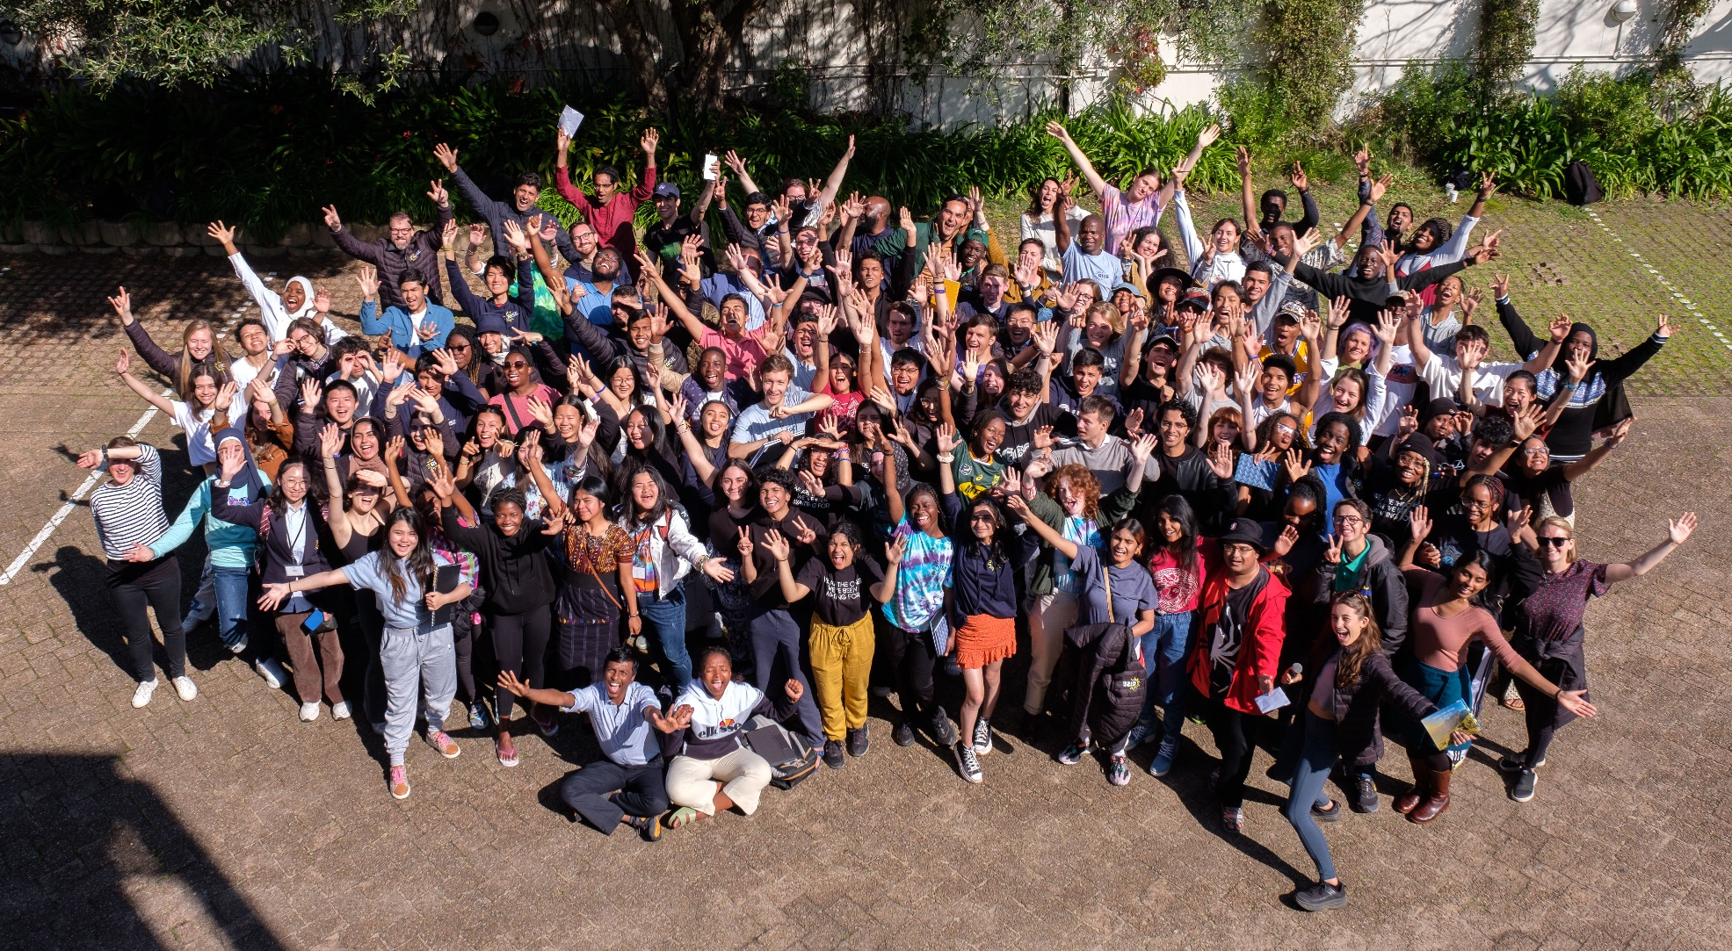
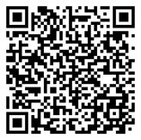
Follow @risefortheworld on social media | Visit www.risefortheworld.org/global-social-leaders
Notes:
Talking points:
Please use this slide to wrap up and have audience scan QR code or go to your unique link to register for the challenge.
Open up for Q&As
Sample Script:
“I am going to pause here to give everyone a chance to scan the QR or enter the link into their browser to register for the Rise Challenge, it takes about 2 minutes to complete. You will just need to enter your email and set up an account.
[Pause]
Thank you! What questions do you have about Rise, our benefits, the Rise Challenge, etc.?”
If you are presenting with a Rise Global Winner, please ask them to share any parting words of advice or encouragement.
Sample Script:
“Do you have any final words of advice/encouragement?”

