Slide 1
How Do You Apply?
Notes:
Talking points:
Please use this slide to let audience know of how they can apply.
Sample Script:
“So now that we heard about all of the amazing benefits of Rise, let’s dive into how you can apply!”

Slide 2
Rise Challenge Process
Complete application by January 17 2024!
01
Register
02
Tell us about you
03
Complete a project
04
Quizzes & Games
05
Peer Reviews
Notes:
Talking points:
Please use this slide to let audience know of how they can apply.
Highlight the Rise Challenge Project
Highlight the application is video-based
Note: If your audience does not have technology access, there is a paper application process; however, we encourage organizations to help youth through our video-based application pathway
Sample Script:
“The Rise Challenge includes registering, telling us about yourself, completing a project that addresses a problem either in the world or your local community, participating in quizzes & games, and providing feedback on other applicant’s projects.
The application platform is video-based and you will have the opportunity to submit videos for some sections of the Challenge.”

Slide 3
Application Timeline
2023
July 1
Registration Opens
2024
January 17
Application Deadline
2024
July-August
Selection
2023
September 28
Application Available
2024
June
Finalist Interviews
2024
September
Winner Announcement
Notes:
Talking points:
Please use this slide to let audience know the application timeline
“Registration for the 2023-2024 Rise Challenge is now open. We encourage all of you to register with the link and QR code that I will show on the next slide. The Challenge will officially open on September 28- where you can start the steps of telling us about yourself and completing your Rise Challenge project, quizzes & games, and peer reviews.
By registering now- you will receive a notification directly to your email when the Challenge officially begins at date in September.
Application for the Rise Challenge will close on January 17, but we strongly encourage you to start early to have ample time to put your best foot forward toward becoming a Rise Global Winner.”

Slide 4
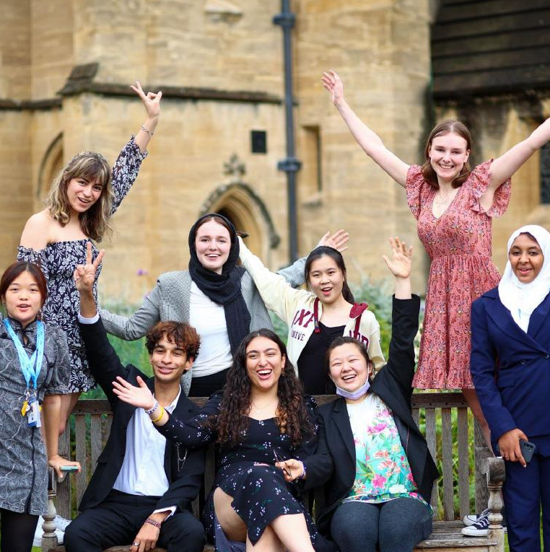
Eligibility Requirements
Applicants for the 2024 cohort must be between the ages of 15 and 17 as of July 1, 2024, meaning they are born on or between July 2, 2006 and July 1, 2009.
Notes:
Talking points:
Please use this slide to let audience know of the eligibility requirements.
This is a strict eligibility requirement and there are no exceptions made. If someone is out the age range, please encourage them to share the Rise opportunity with their peers or network for others who can apply
Sample Script:
“One particular thing I want to highlight is the eligibility requirement.
Rise starts at ages 15-17 and encourages a lifetime of service. Applicants must be between the ages of 15-17 when they apply, meaning they must be born on or in between July 2, 2006 and July 1, 2009.
It does not matter what country you live in, background you come from, or academic experience you have. Whether you are interested in science, innovation, technology, art, policy, community organizing, or any other discipline—Rise wants to hear from you!
Videos for the Rise Challenge must be submitted in English, but you do not need to submit TESOL/TEFL scores as part of your application.”

Slide 5
Further Details
Rise Finalists
Up to 500 Finalists advance to Finalist Days, where they demonstrate their motivations, problem-solving abilities, and teamwork skills in an innovative interview format.
Rise Global Winners
Up to 100 Global Winners are selected and provided with opportunity as they work to serve others.
Notes:
Talking points:
Please use this slide to let audience know the selection steps to becoming a Rise Global Winner
Please make sure you use the phrase “up to” when stating the number of finalists and winners
Sample script
“After completing the Rise Challenge, applications are evaluated and our team selects up to 500 finalists to participate in a Rise finalist day where you will have further opportunities to demonstrate your capabilities of the Rise Traits. The finalists days consists of activities to showcase your motivations, problem solving abilities, and teamwork skills in an innovative interview format.”
If you are presenting with a Rise Global Winner, please ask them to share their experience as a Finalist.
Sample Script:
“What was your experience like during Finalist Days? What was something you learned about yourself or even other finalists?”

Slide 6
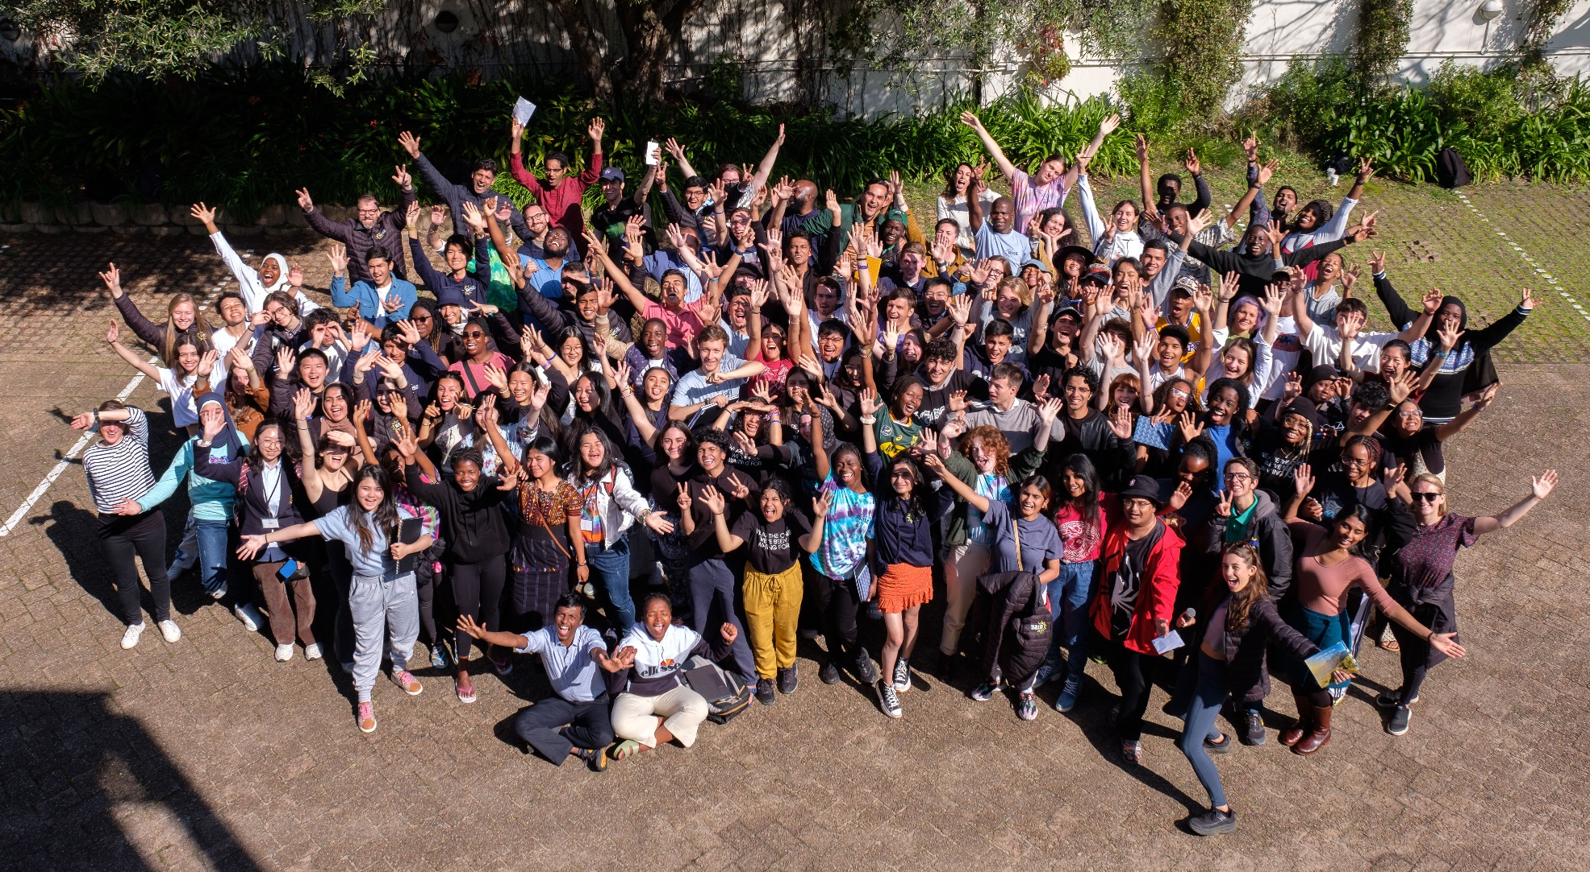
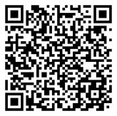
Follow @risefortheworld on social media | APPLY HERE: www.risefortheworld.org/global-social-leaders
Notes:
Talking points:
Please use this slide to wrap up and have audience scan QR code or go to your unique link to register for the challenge.
Open up for Q&As
Sample Script:
“I am going to pause here to give everyone a chance to scan the QR or enter the link into their browser to register for the Rise Challenge, it takes about 2 minutes to complete. You will just need to enter your email and set up an account.
[Pause]
Thank you! What questions do you have about Rise, our benefits, the Rise Challenge, etc.?”
If you are presenting with a Rise Global Winner, please ask them to share any parting words of advice or encouragement.
Sample Script:
“Do you have any final words of advice/encouragement?”

Slide 7
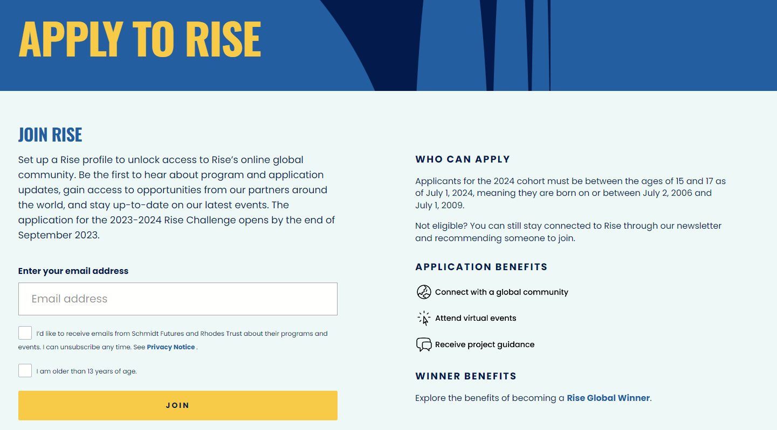
Notes:
Explain Attitude, Skills, Resources.3 minutes to discuss and list "What makes a good leader?"

