Slide 1
RISE INFORMATION SESSION
Notes:
Talking points:
Please use this slide to introduce yourself and let audience know that you are excited to tell them about Rise.
Sample script:
“Hello, Everyone! My name is [INSERT NAME] and I am [INSERT ROLE & ORGANIZATION]. I am excited to meet you all and let you know more about Rise.”
If you are presenting with a Rise Global Winner, please take a moment to have them introduce themselves stating their name, what country they are from, and how they learned about Rise.
Sample script:
“Can you take a moment to introduce yourself, tell us a little about you, where you are from, and how you learned about Rise?”

Slide 2
Rise is a program that finds promising young people and provides opportunity as they work to serve others.
Notes:
Talking points:
Please use this slide to describe the Rise program.
Sample script:
For those of you who have not heard, Rise is a program that finds promising young people and provides them with opportunities as they work to serve others.”

Slide 3
The world’s most important problems will be solved by the next generation of leaders.
If one person alone can change the world, imagine what a network of exceptional people can do together throughout their lives. That is the vision of Rise.
Notes:
Talking points:
Please use this slide to describe the the founding of the Rise program.
Sample script:
“Rise believes that the world’s most important problems will be solved by the next generation of leaders. We know from history that one person alone can change the world–at Rise we are building a network of exceptional people who will make a positive impact together throughout their lives. That is the vision of Rise.”

Slide 4
Rise Applicant Benefits

Slide 5
Everyone who applies…
Joins a global community and can participate in the Rise Discord
Experiences project-based learning and human-centered design approaches for social impact
Learns about opportunities from our partners
Notes:
Talking points:
Please use this slide to let audience know that Rise offers benefits to everyone who applies
Highlight the value of project-based learning
Highlight the value of connecting with like-minded peers on Discord from across the globe to build a new network community
Highlight Rise as a clearing house for opportunity from our network
Highlight Rise Global Community events open to all of our applicants
Sample script:
“Everyone who applies to Rise, from anywhere in the world, gains a network of peers, and a specially curated offering of opportunities from Rise’s partners around the globe. The Rise Discord chat is full of exceptional young people looking to connect with one another to come together and solve the world’s most pressing problems.
[Pause]
As I mentioned earlier, everyone who completes the Rise Challenge gains the benefit of project-based learning and human-centered design approaches geared toward social impact. This experience can challenge [you, young people, students, etc.- adjust word to fit audience] to come up with new ideas and creative ways to solve problems that [you, young people, students, etc.- adjust word to fit audience] can take throughout [your, their, young people’s, student’s, etc.- adjust word to fit audience] life.”
If you are presenting with a Rise Global Winner, please ask them to describe their thoughts on how applying to Rise was beneficial.
Sample script:
“What was your experience with the Rise Global Community on Discord when applying?”
“What did you learn from the project-based learning Rise Challenge? How did this benefit you?”

Slide 6
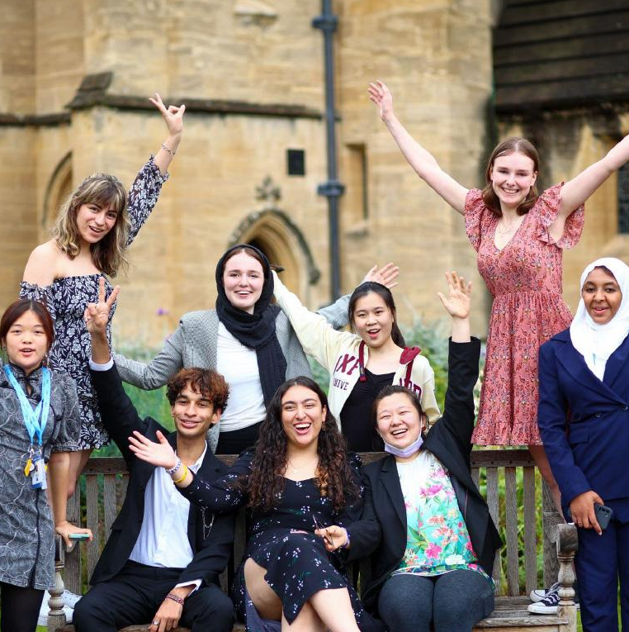
Eligibility Requirements
Applicants for the 2024 cohort must be between the ages of 15 and 17 as of July 1, 2024, meaning they are born on or between July 2, 2006 and July 1, 2009.
Notes:
Talking points:
Please use this slide to let audience know of the eligibility requirements.
This is a strict eligibility requirement and there are no exceptions made. If someone is out the age range, please encourage them to share the Rise opportunity with their peers or network for others who can apply
Sample Script:
“One particular thing I want to highlight is the eligibility requirement.
Rise starts at ages 15-17 and encourages a lifetime of service. Applicants must be between the ages of 15-17 when they apply, meaning they must be born on or in between July 2, 2006 and July 1, 2009.
It does not matter what country you live in, background you come from, or academic experience you have. Whether you are interested in science, innovation, technology, art, policy, community organizing, or any other discipline—Rise wants to hear from you!
Videos for the Rise Challenge must be submitted in English, but you do not need to submit TESOL/TEFL scores as part of your application.”

Slide 7
Rise Winner Benefits

Slide 8
Attend Residential Summit with other Rise Global Winners from their cohort
Opportunity to apply for a four-year, post-secondary needs-based higher education scholarship
Chance to apply for funding for innovative ideas on a competitive basis
Access to our network connecting Rise Global Winners, community members, and partner organizations
Receive starter technology packages, such as laptops or tablets
Notes:
Talking points:
Please use this slide to let audience know of the Rise Global Winner Benefits
When referring to # of Winners, please use phrase “up to 100”
Sample Script:
“Rise selects up to 100 Winners each year and receive benefits to help them scale their impact. These benefits may include a fully funded residential summit, need-based higher education scholarships, funding for ideas on a competitive basis, access to a network of other Rise Global Winners, starter technology packages, mentorship and career services.”
If you are presenting with a Rise Global Winner, please ask them to share their experience as a Rise Global Winner.
Sample Script:
“Can you talk about the experience of being a Winner. What have you gained?”

Slide 9
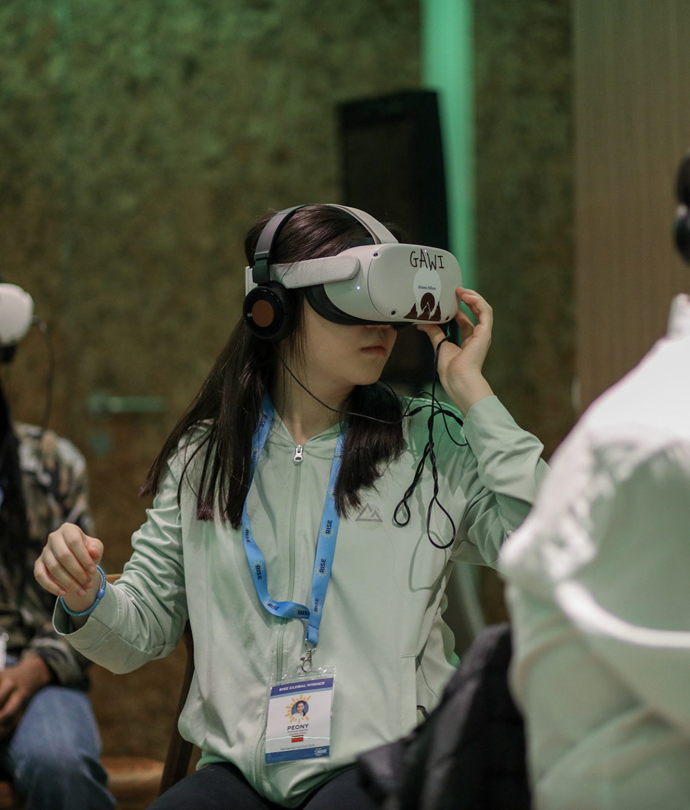
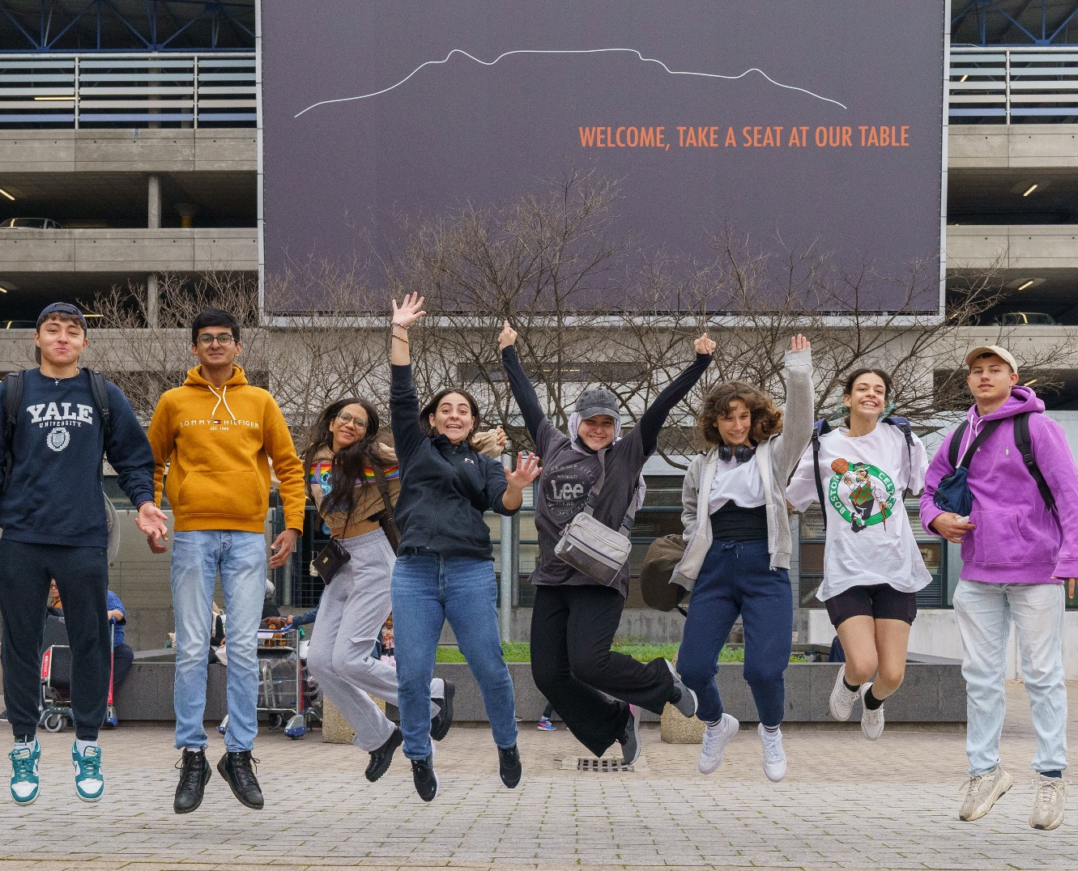
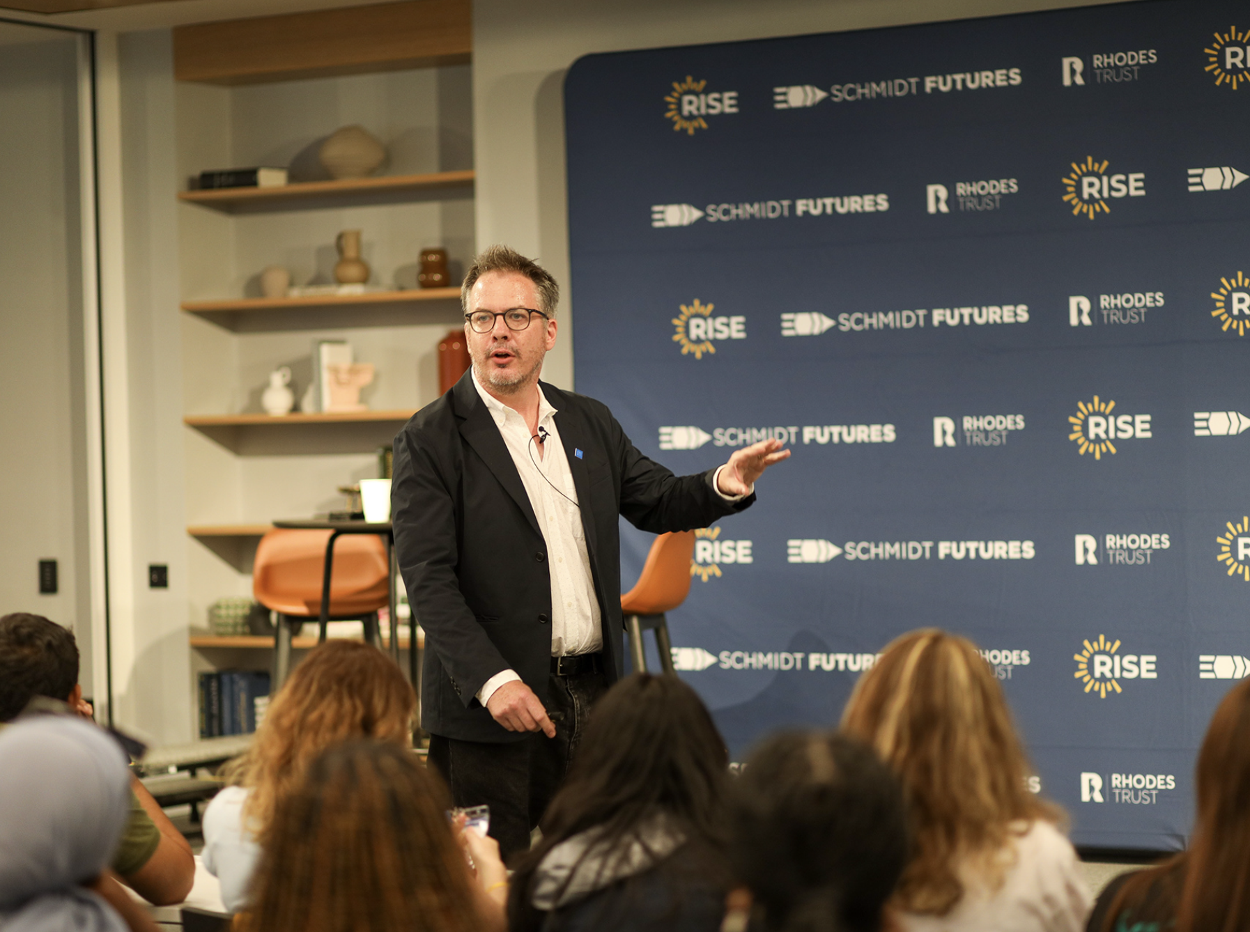
The Rise Residential Summit
All Rise Global Winners receive an invitation to attend a fully-funded, residential summit.
During the Summit, our cohorts work together in-person to find solutions for society’s most pressing problems.
Summits have been held in Cape Town, South Africa and in London and Oxford, UK. While there, they built community, learned from experts, and completed Capstone projects.
Notes:
Talking points:
Please use this slide to discuss the Rise Residential Summit.
Highlight any activities that you received in RRS email updates or from RGW that your organization has heard from.
Sample Script:
“The Rise Residential Summit is an opportunity for our Winner cohort to come together and connect in person to share ideas and learn new skills from experts. The first cohort convened in South Africa and the second cohort spent time in London and Oxford. During the Summit Winners are exposed to various new disciplines, and have the chance to explore culture, history, and art of the host country. In the most recent Summit, Winners visited 10 Downing Street and the Crick Institute, learned about Circular Economies during our Climate and Sustainability programming days, heard from multiple guests about entrepreneurship and launching ventures, and even had the opportunity to explore astrophysics with experts!”

Slide 10
Where are Rise Winners Today
Rise Global Winners are enrolled at top universities around the world, including:
Notes:
Talking points:
Please use this slide to discuss the Needs-Based Higher Education Scholarship
Highlight that scholarship is based on need and includes tuition and living stipend that are not already covered by financial aid
Highlight this benefit applies to any accredited university across the globe, not just in the US
Highlight the universities where some of the Rise Global Winners are attending
Sample Script:
“In addition to the Rise Residential Summit, Rise Global Winners receive a four-year, post-secondary scholarship at any accredited university across the globe, that includes tuition and a living stipend, based on need and not already covered by financial aid.
Many of Rise Global Winners are enrolled at some of the top institutions including Yale, Stanford, MIT, and Oxford. We are also partnered with many universities in the US and abroad and have a dedicated support team that guides our Winners through the college application process.”

Slide 11
GSL CATALYST COURSE

Slide 12
What is the GSL Catalyst Course?
This transformational leadership initiative for those aged 15 to 17 is designed to empower and equip you with the skills to be a leader in your lives and society.
It is designed to equip you with the SKILLS, KNOWLEDGE, VALUES & CONFIDENCE to inspire change and create a positive impact in your communities!
Note: Applicants must be 15-17 as of July 1, 2024, meaning they were born on or between July 2, 2006 and July 1, 2009

Slide 13
What is the Leadership Training?

Slide 14
Training Outline
A Two hour virtual leadership and social action training ​
Interactive activities and sessions to support your personal development journey​
An opportunity to meet new people, learn from other project ideas and be inspired! ​
The topics that will be covered as part of the training include the following:​
Leadership Essentials & Mapping your Journey​
Project Design & Action ​
Creating a Collective vision ​
Community Building 101​
Project Inspiration & Stories ​
​

Slide 15
When will this be running?
​NOVEMBER
8:00 - 10:00 AM UK Time – Tuesday 7th November 2023
3:00 - 5:00 PM UK Time –Tuesday 7th November 2023
8:00 - 10:00 AM UK Time – Saturday 25th November 2023
3:00 - 5:00 PM UK Time – Saturday 25th November 2023
Where: via Zoom - all registered students will receive joining instructions nearer to the sessions.

Slide 16
Please make sure to also confirm your participation with your teacher who will be adding you a Student List for this programme! ​

Slide 17
REGISTER TO RISE NOW VIA THIS LINK!

Slide 18
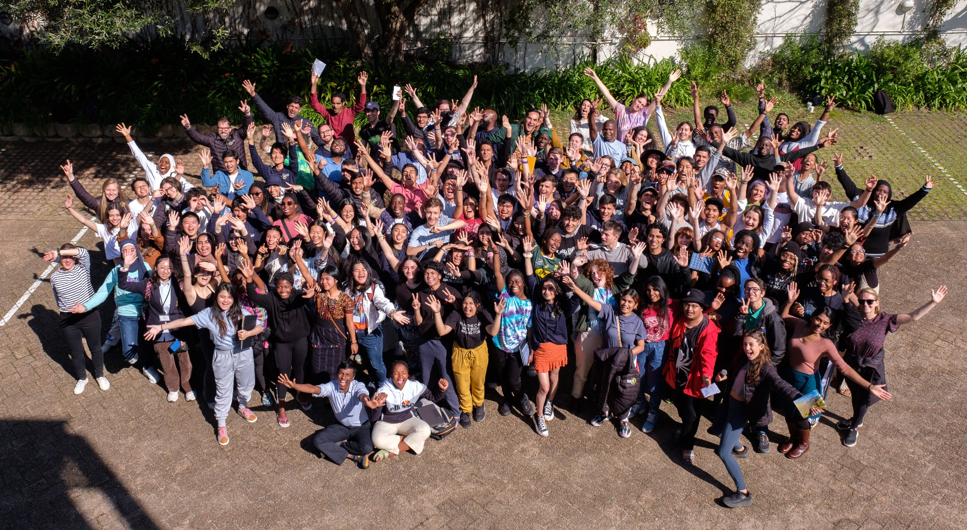
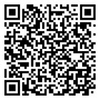
Follow @risefortheworld on social media | APPLY HERE: www.risefortheworld.org/global-social-leaders
Notes:
Talking points:
Please use this slide to wrap up and have audience scan QR code or go to your unique link to register for the challenge.
Open up for Q&As
Sample Script:
“I am going to pause here to give everyone a chance to scan the QR or enter the link into their browser to register for the Rise Challenge, it takes about 2 minutes to complete. You will just need to enter your email and set up an account.
[Pause]
Thank you! What questions do you have about Rise, our benefits, the Rise Challenge, etc.?”
If you are presenting with a Rise Global Winner, please ask them to share any parting words of advice or encouragement.
Sample Script:
“Do you have any final words of advice/encouragement?”

